Slide 1
TOURIST ATTRACTIONS OF OUR REGION Bratislava region danubiana MEULENSTEEN ART museum

Slide 2
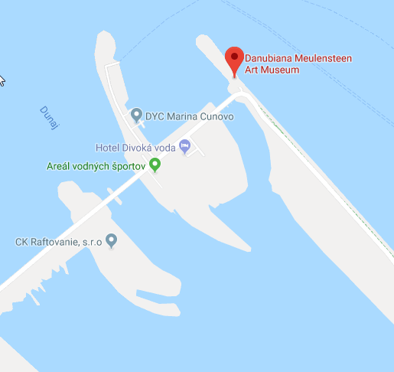
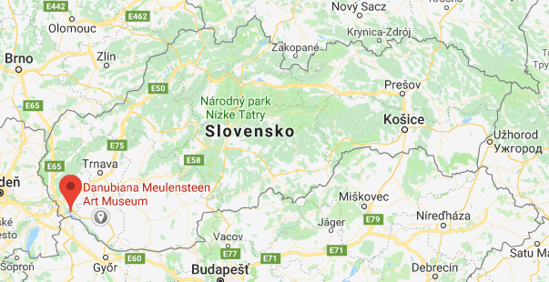
BRATISLAVA REGION DANUBIANA MEULENSTEEN ART MUSEUM
Bratislava
Map of the country
Map of the area with other sites

Slide 3
BRATISLAVA REGION DANUBIANA MEULENSTEEN ART MUSEUM
TIPE OF SITE
It is a museum of modern art
PHYSICAL AND AESTHETIC FEATURES
The Danubiana’s unique location on the borders of Slovakia, Hungary and Austria, and its harmonious combination of museum architecture and the surrounding Danube River landscape offer visitors unique views of the artwork as well as the flora and fauna which change with the seasons. The permanent exposition is comprised of an international collection, a collection of Dutch art and a collection of Slovak art. The artworks featured in this exposition come from two sources. Most of the pieces are from the collection of Gerard Meulensteen (the founder of the Danubiana)
AREA COVERED
It covers an area of 8000 m2 including the park
HISTORICAL/SCIENTIFIC/ARTISTIC INFORMATION
The goal of this gallery was to continue in the ideas which the famous artist strived for more than 100 years ago in Arles, France. Gerard Meulensteen and Vincent Polakovič, who in 1998 visited the Louisiana Museum in Denmark, decided to build modern art museum in Bratislava that would allow local and foreign artists to exhibit their work in modern spaces with attractive architecture.
DATING
The birth of the Danubiana dates back to 1990. The museum was opened for the first time on 9th of September 2000.

Slide 4
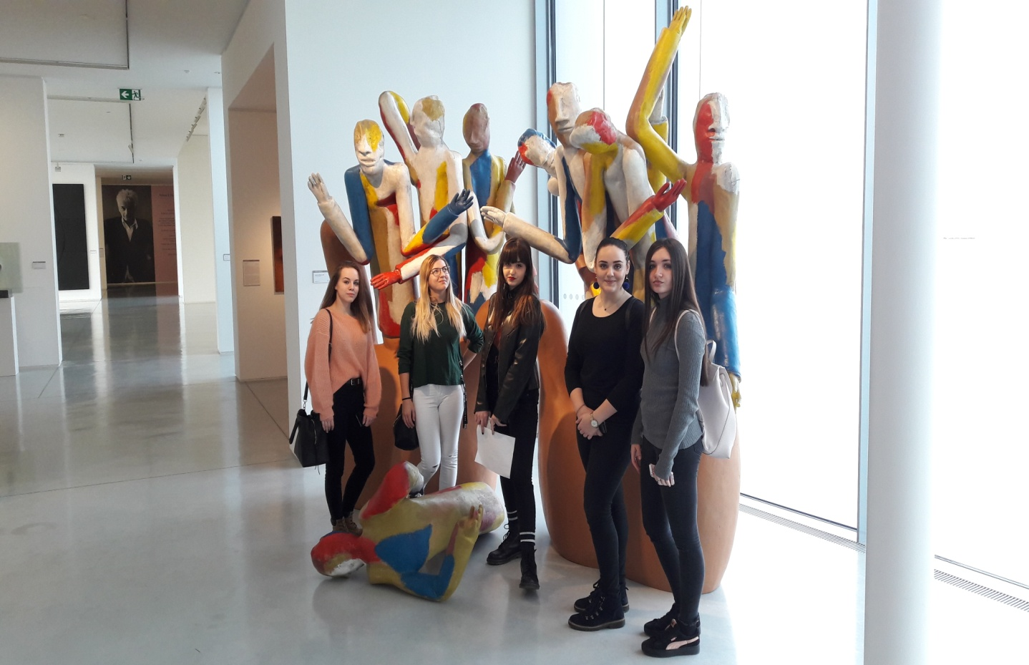
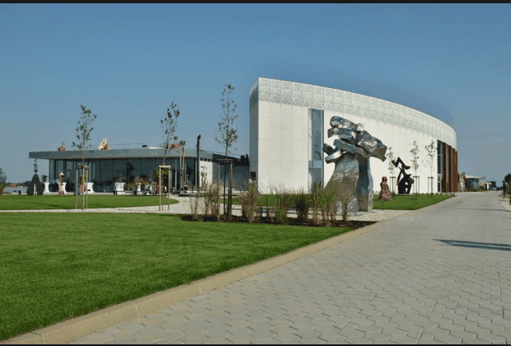
BRATISLAVA REGION DANUBIANA MEULENSTEEN ART MUSEUM
HIGHLIGHTS

Slide 5
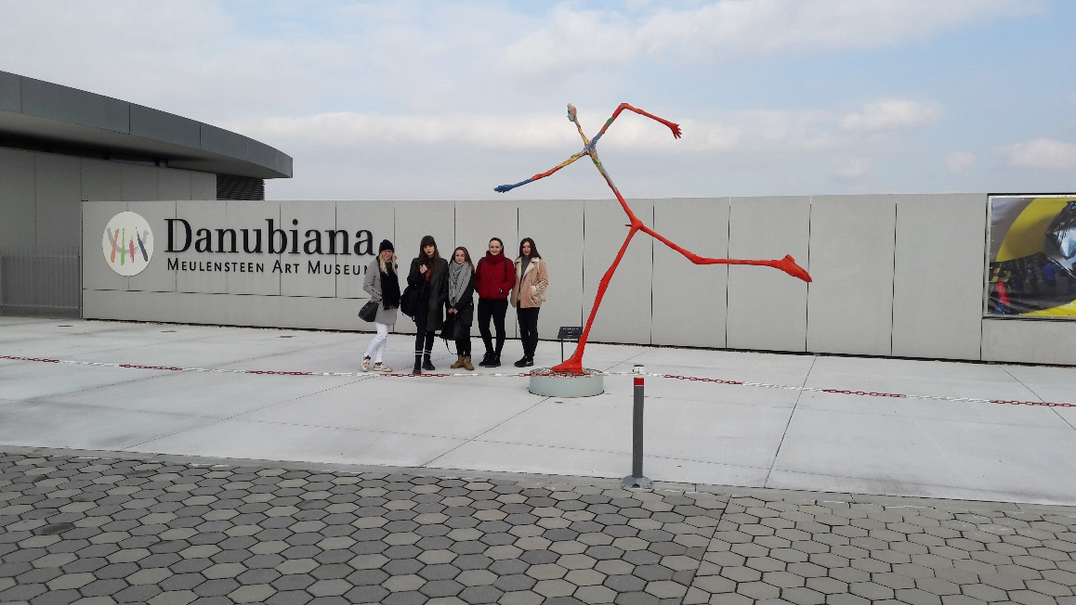
BRATISLAVA REGION DANUBIANA MEULENSTEEN ART MUSEUM
CONDITION OF PRESERVATION
The condition of the museum is very good because it is a young building.
VISITING TIME
Opening Hours:
10:00 A.M. – 6:00 P.M.
Closed on Mondays.
LEGAL OWNERSHIP
In 2011, Gerard Meulensteen donated his museum to the Slovak Republic which the Government of the Slovak Republic was happy to accept.
TICKETS AND BOOKING
You can reserve tickets via an email or buy tickets on the spot . Adults 10 €, children & students 5 €, family ticket 20 €.

Slide 6
BRATISLAVA REGION DANUBIANA MEULENSTEEN ART MUSEUM
ACCESSIBILITY
The easiest and most convenient way to get here is by car. You can also use the public transportation. There is also an option to take a boat or use a bike. It is also accessible for disabled people.
FACILITIES
In Danubiana you can visit an art shop with a wide selection of catalogues, art publications, postcards, souvenirs, and the cosy Art Café, which extends beyond the gallery and allows visitors to sit right on the bank of the Danube. Along with the beautiful exhibitions, as a bonus, you can enjoy the interesting park covering an area of 8000 m2, where 60 sculptures are presented. Along with the beautiful exhibitions, as a bonus, you can enjoy the interesting park covering an area of 8000 m2, where 60 sculptures are presented. If you arrive by car, there are many parking lots to use in front of the museum. Near this museum you can find the water sports resort.

Slide 7
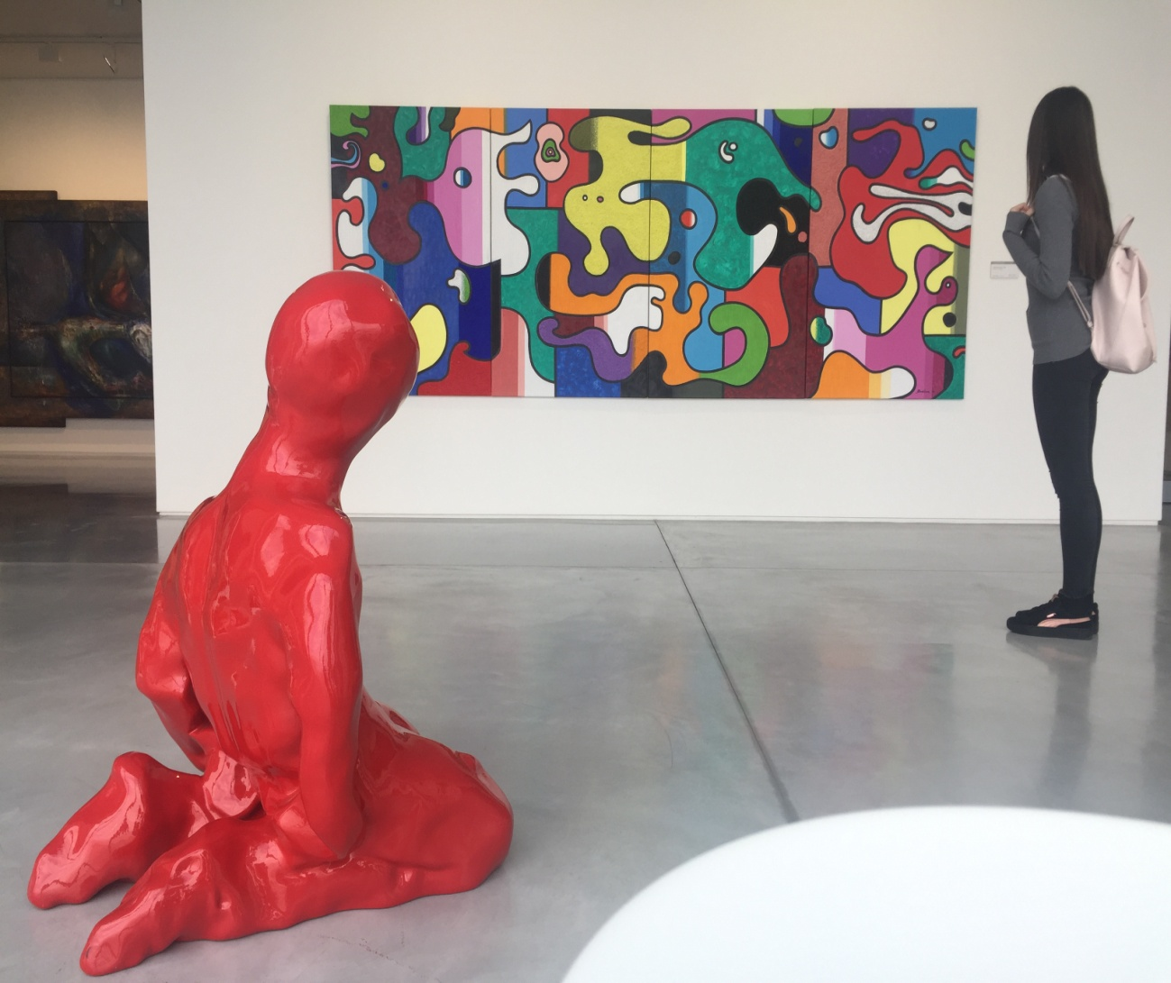
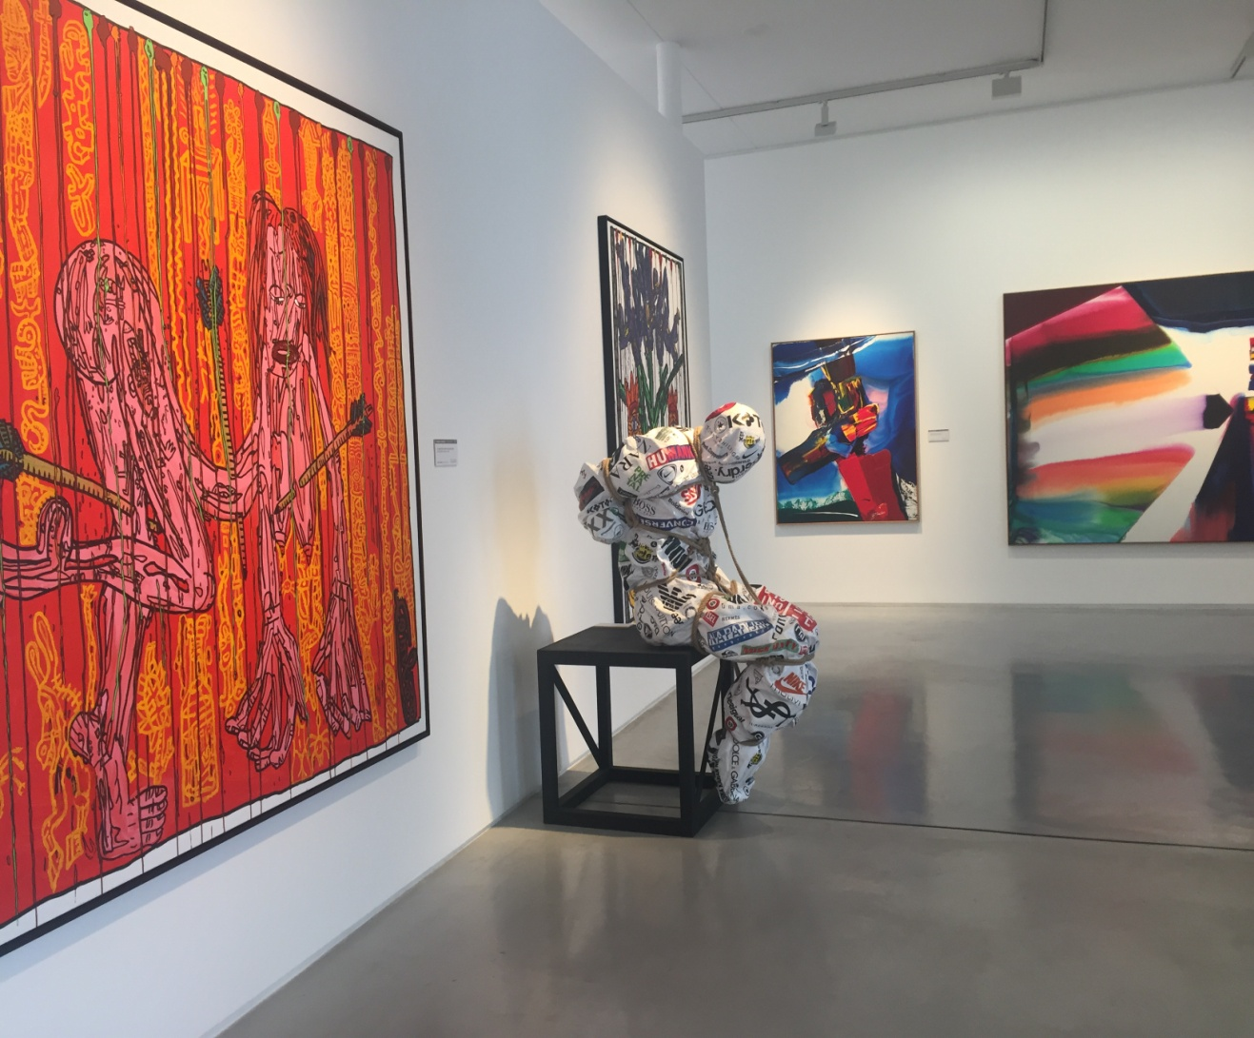
BRATISLAVA REGION DANUBIANA MEULENSTEEN ART MUSEUM

